Slide 1
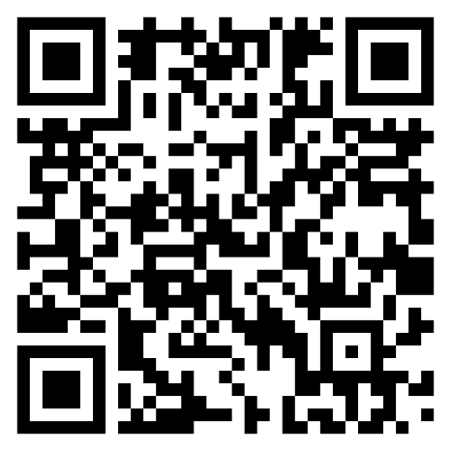




From True Cost to True Change Reflexive insights from 4 years of FOODCoST project
Final FOODCoST Conference
Brussels – 23 April 2026
Philippe Baret
Anne-Maud Courtois
Diana Borniotto

Slide 2
Food systems have diverse impacts
Health impacts
Beyond their productive function, agricultural and food systems generate positive and negative externalities
Mapping these externalities is a complex task
Some externalities are better known and understood than others
Environmental impacts
Social impacts
Economic impacts

Slide 3
Sources of these externalities
Health impacts
Different stages of the value chain contribute to these externalities
Causal chains are sometimes difficult to reconstruct
At each level, a diversity of production and consumption modes contributes differently to total externalities
Consumption
Environmental impacts
Value chains
Social impacts
Production
Economic impacts

Slide 4
Sources of these externalities
Health impacts
Different stages of the value chain contribute to these externalities
Causal chains are sometimes difficult to reconstruct
At each level, a diversity of production and consumption modes contributes differently to total externalities
Consumption
Environmental impacts
Ethical consideration
Holding stakeholders accountable while recognising their diversity
Within the coexistence of systems, assigning each a share proportional to its impact
Value chains
Social impacts
Production
Economic impacts

Slide 5
From externalities to cost
Monetising externalities allows their cost to be calculated
Health impacts
Consumption
Environmental impacts
Value chains
Externalities calculation
Social impacts
Production
Economic impacts

Slide 6
Today, the question of the cost of agricultural and food systems is mainly used as an advocacy tool
From cost to action
Individual actions
Business logic
Advocacy
Public policies
Health impact
It can also help influence individual actions, market logic and public policies.
Environnemental impacts
Externalities calculation
Social impacts
Economic impacts

Slide 7
Individual actions
Advocacy
Business logic
Public policies
Health impacts
Consumer behaviour
Consumption
Costs imputation
Environmental impacts
Internalisation of externalities
Choices within value chains
Value chains
Externalities calculation
Social impacts
Ecological investments
Modes of production
Production
Economic impacts

Slide 8
From cost to action
Individual actions
Addressing environmental, social and public health challenges requires alignment between policies, markets and practices
Business logic
Public policies
Consumer behaviour
Costs imputation
Internalisation of externalities
Choices within value chains
Ecological investments
Modes of production

Slide 9
Public policies
Individual actions
Internalizing externalities in public policies
Taxes
Regulations
Public procurements
Subsides
Business logic
Public policy
Consumer behaviour
Costs imputation
Internalisation of externalities
Choices within value chains
Coinon et al., 2023
Ecological investments
Modes of production

Slide 10
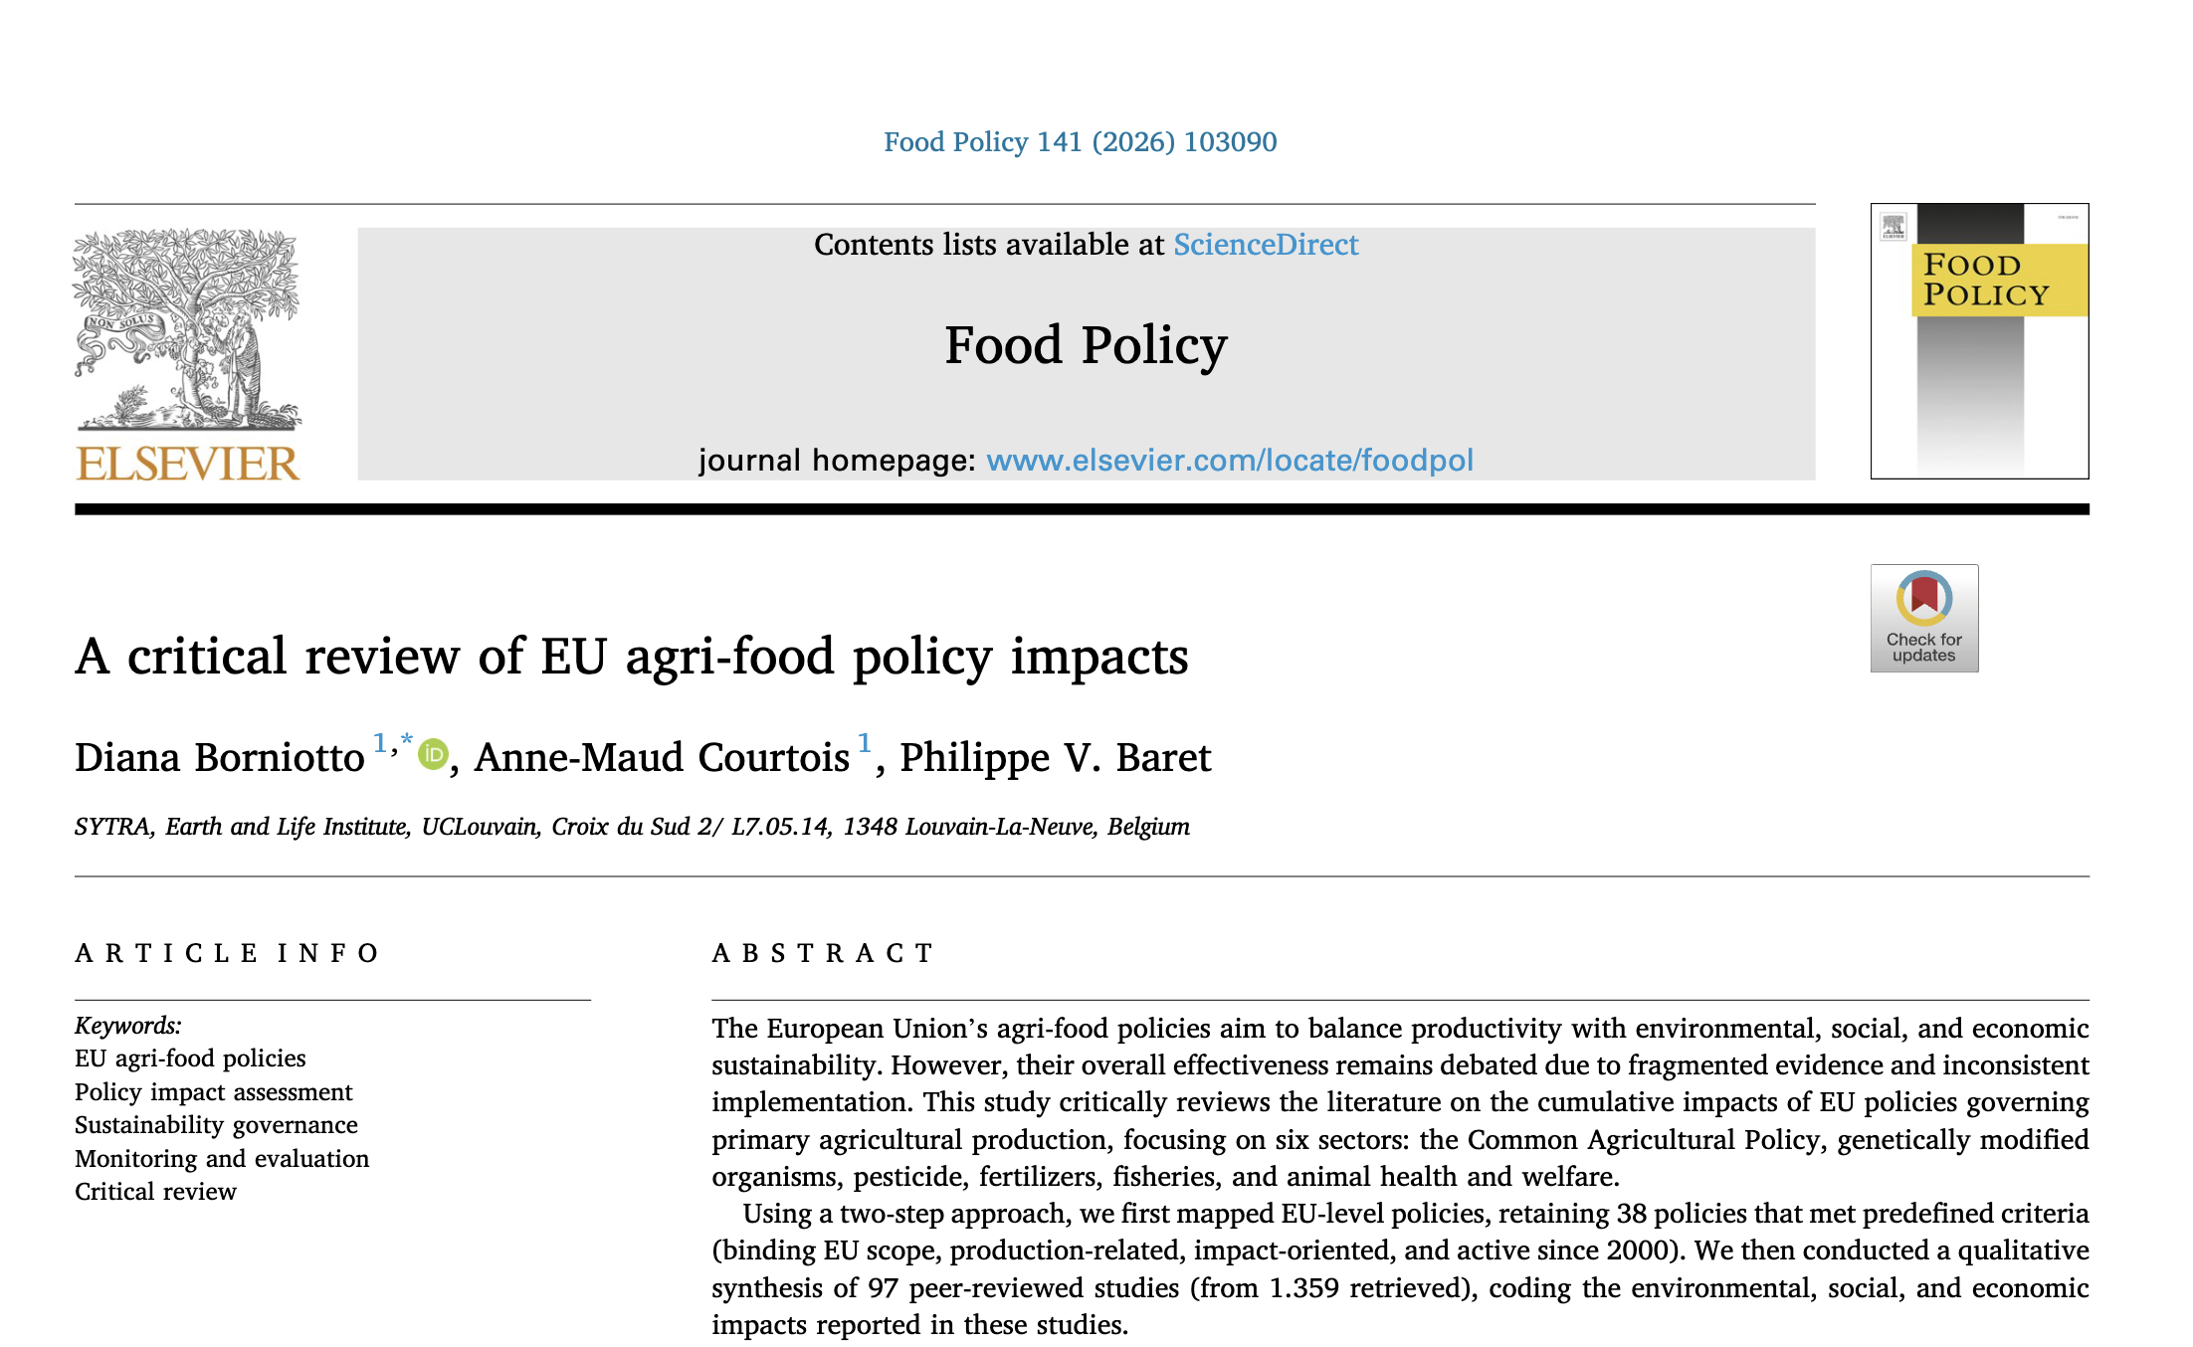
Learn more about policy impacts ?
Just published

Slide 11
Business logic
Individual actions
Internalizing externalities in business models
Product and process innovation
Value chain reconfiguration
Measurement & accreditation tools
Consumer/market recognition
Innovative financing
Business logic
Public policy
Consumer behaviour
Costs imputation
Internalisation of externalities
Choices within value chains
Ecological investments
Modes of production
Mehrabi and Giagnocavo (2024)

Slide 12
Impact pathways
Regulatory measures
EU Policies
Reduce externalities
Objective
Economic mechanisms
Path of action
Calculations

Slide 13


Impact pathways
Regulatory measures
EU Policies
Lock-ins
Reduce externalities
Business models
Objective
Economic mechanisms
Path of action
Calculations

Slide 14
Impact pathways
Regulatory measures
EU Policies
Lock-ins
Reduce externalities
Business models
Objective
Economic mechanisms
Path of action
Calculations

Slide 15

Result - FOODCoST produced
A guidebook to map lock-ins
A checklist of 58 barriers to the internalisation of externalities in food systems

Slide 16

Lock-in within the policy cycle
Examples of barriers
Long-term policy uncertainties
Lack of EU policy harmonization
Lack of policy support
Opposing lobbying forces
Inequal allocation of resources
Unfavourable regulations
Lack of regulatory flexibility
Lack of legal recognition of internalization
Lack of properly defined property rights
Lack of binding rules and sanctions

Slide 17
Lock-in within business logic
Examples of barriers
Market misalignment
Low willingness to pay for internalized products
Competition/uneven playing field with conventional
Greenwashing
Inadequate financial incentives
Lack of predictability on returns
High upfront investment needs
Strong re-organization needs
Tedious administrative procedures
Inadapted managment structures
Socio-cultural resistance to change
…

Slide 18
Impact pathways
Regulatory measures
EU Policies
Lock-ins
Reduce externalities
Business models
Objective
Economic mechanisms
Path of action
Calculations

Slide 19
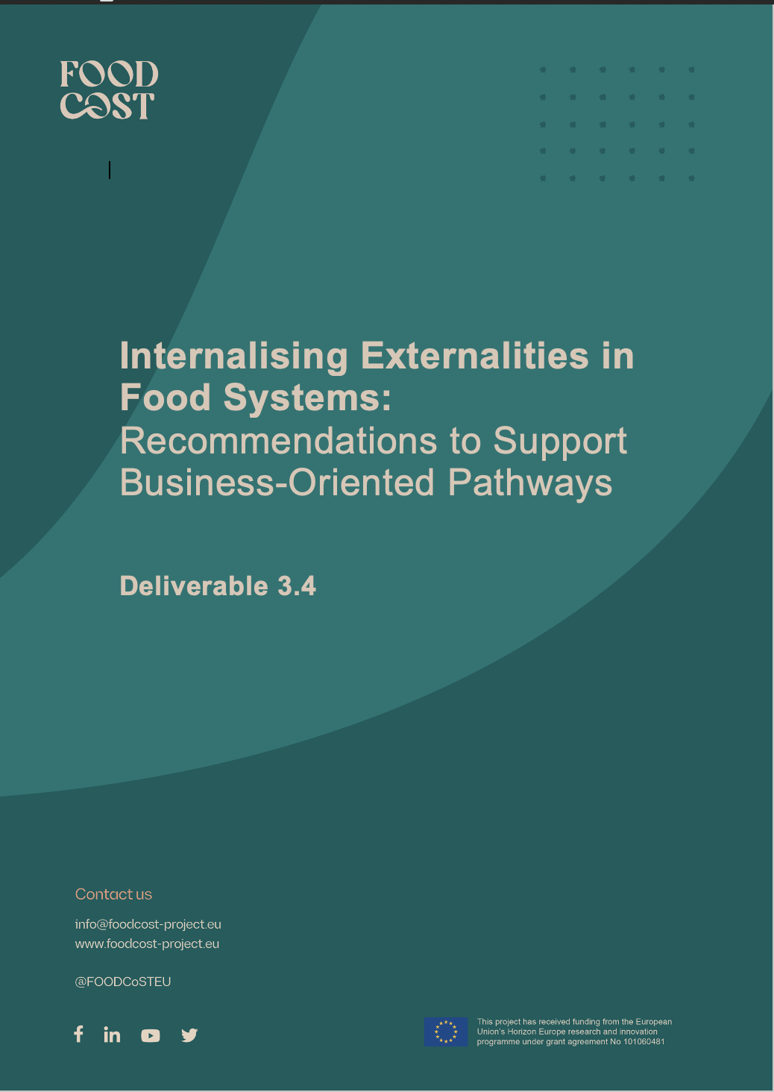
Result - FOODCoST produced
A set of 22 recommendations to support business-oriented actions to reduce/suppress externalities
Available in a few days!

Slide 22
Looking at these actions, some are supported by strong calculation methodologies

Slide 23
Action driven calculation
Individual actions
Advocacy
Business logic
Public policies
Health impacts
Consumer behaviour
Consumption
Costs imputation
Environmental impacts
Internalisation of externalities
Choices within value chains
Value chains
Externalities calculation
Social impacts
Ecological investments
Modes of production
Production
Economic impacts

Slide 24
… some of these actions are policy-influenced

Slide 25
… but most are ready to deploy !

Slide 26
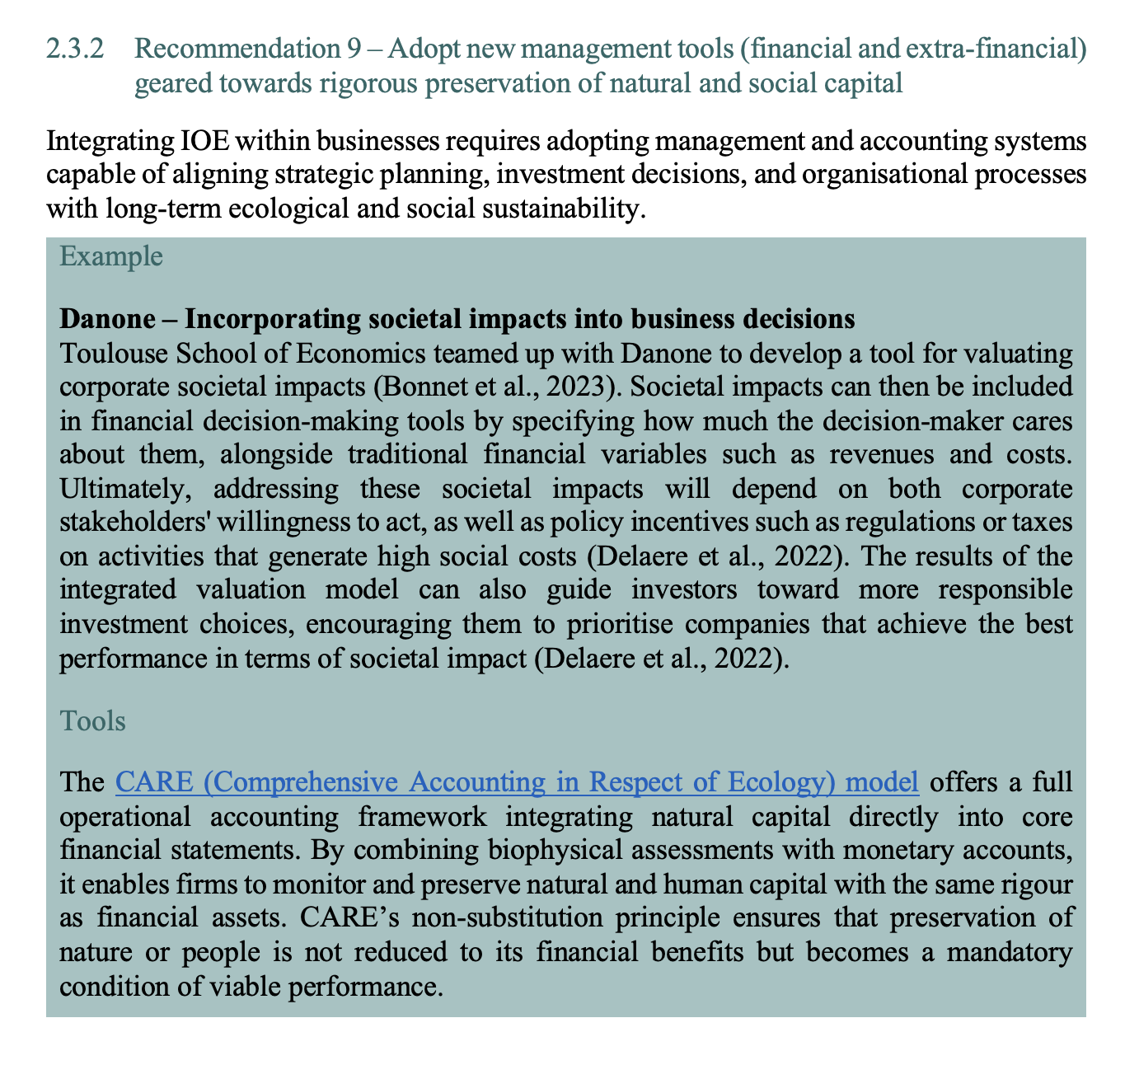














Examples of business already acting

Slide 27
We can act now, in parallel to methodological clarifications and policy alignment
This radical objective
[suppressing externalities]
remains urgent

Slide 29


